Slide 1
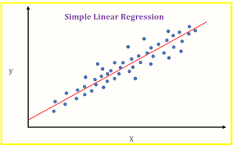
LINEAR REGRESSION AND CLASSIFICATION
TEAM 11
122010324018- SALEEM
122010324055-MOURYA
122010324056-NITHIN

Slide 2
Linear regression
Linear regression is one of the easiest and most popular Machine Learning algorithms. It is a statistical method that is used for predictive analysis. Linear regression makes predictions for continuous/real or numeric variables such as sales,salary,age etc.
Linear regression algorithm shows a linear relationship between a dependent (y) and one or more independent (y) variables, hence called as linear regression. Since linear regression shows the linear relationship, which means it finds how the value of the dependent variable is changing according to the value of the independent variable.

Slide 3
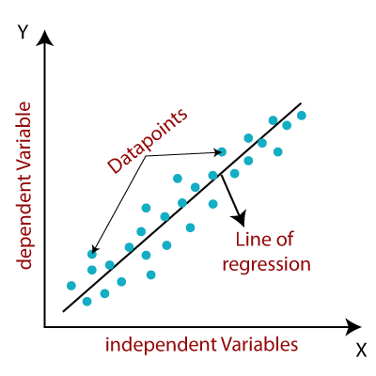
The linear regression model provides a sloped straight line representing the relationship between the variables

Slide 4
Mathematically, we can represent a linear regression as:
y= a₀+a₁x+ ε
Here,
Y= Dependent Variable (Target Variable) X= Independent Variable (predictor Variable) a0= intercept of the line (Gives an additional degree of freedom) a1 = Linear regression coefficient (scale factor to each input value). ε = random error

Slide 5
Types of Linear Regression
Linear regression can be further divided into two types of the algorithm:
Simple Linear Regression: If a single independent variable is used to predict the value of a numerical dependent variable, then such a Linear Regression algorithm is called Simple Linear Regression.
Multiple Linear regression: If more than one independent variable is used to predict the value of a numerical dependent variable, then such a Linear Regression algorithm is called Multiple Linear Regression.

Slide 6
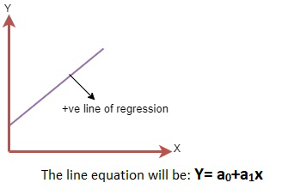
Positive Linear Relationship:
If the dependent variable increases on the Y-axis and independent variable increases on X-axis, then such a relationship is termed as a Positive linear relationship

Slide 7
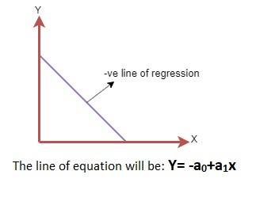
Negative Linear Relationship:
If the dependent variable decreases on the Y-axis and independent variable increases on the X-axis, then such a relationship is called a negative linear relationship.

Slide 8
Classification:
Classification is a process of finding a function which helps in dividing the dataset into classes based on different parameters. In Classification, a computer program is trained on the training dataset and based on that training, it categorizes the data into different classes.

Slide 9
Types of ML Classification Algorithms:
Classification Algorithms can be further divided into the following types:
Logistic Regression
K-Nearest Neighbours
Support Vector Machines
Kernel SVM
Naïve Bayes
Decision Tree Classification
Random Forest Classification

Slide 10
Regression vs. Classification in Machine Learning
Regression and Classification algorithms are Supervised Learning algorithms. Both the algorithms are used for prediction in Machine learning and work with the labeled datasets. But the difference between both is how they are used for different machine learning problems.
The main difference between Regression and Classification algorithms that Regression algorithms are used to predict the continuous values such as price, salary, age, etc. and Classification algorithms are used to predict/Classify the discrete values such as Male or Female, True or False, Spam or Not Spam, etc.

Slide 11
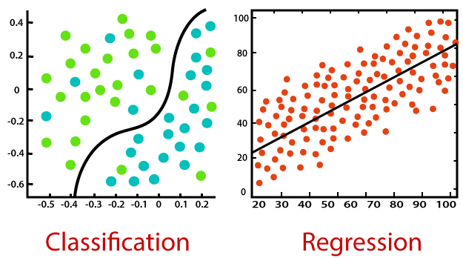

Slide 12
Thank you
By team 11
122010324018
122010324055
122010324056

